Slide 1
Getting Started with DIMA

Slide 2
Advantages of Using DIMA
Rapid data entry, in the field
Quality assurance
Catch errors before they are recorded with built-in error checking
Ensures adhesion to the protocols (i.e., consistency)

Slide 3
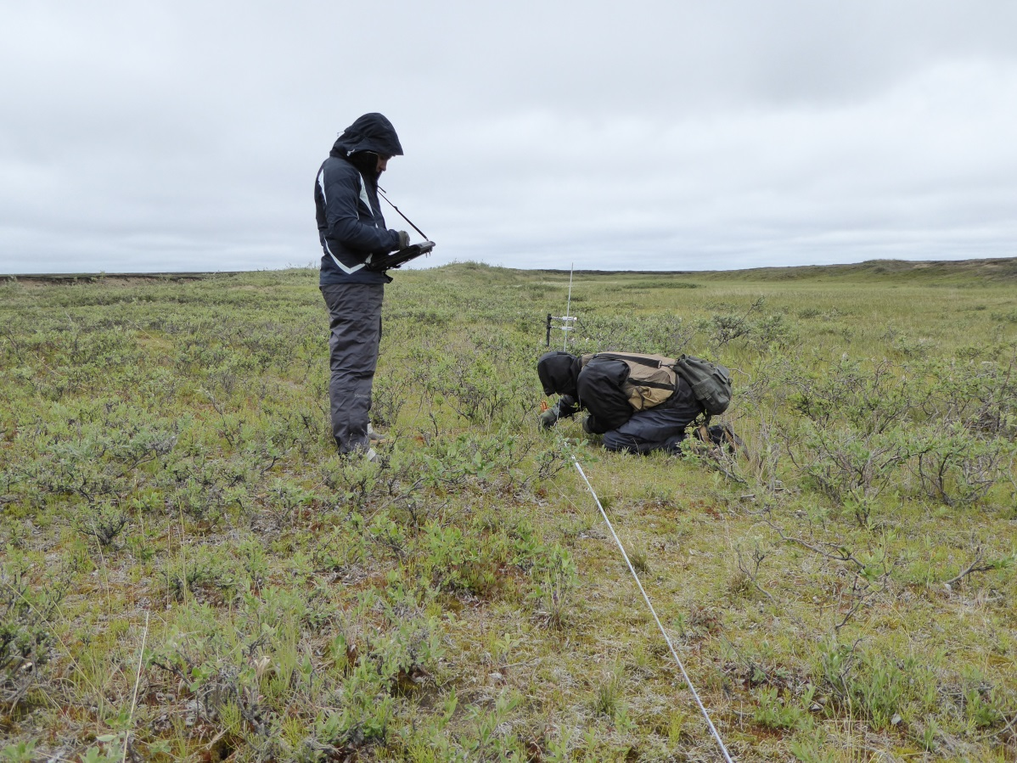
Where to Use DIMA
In the field
Data collection
On the fly reports
In the office
Data entry
QA & QC
Data summaries

Slide 4
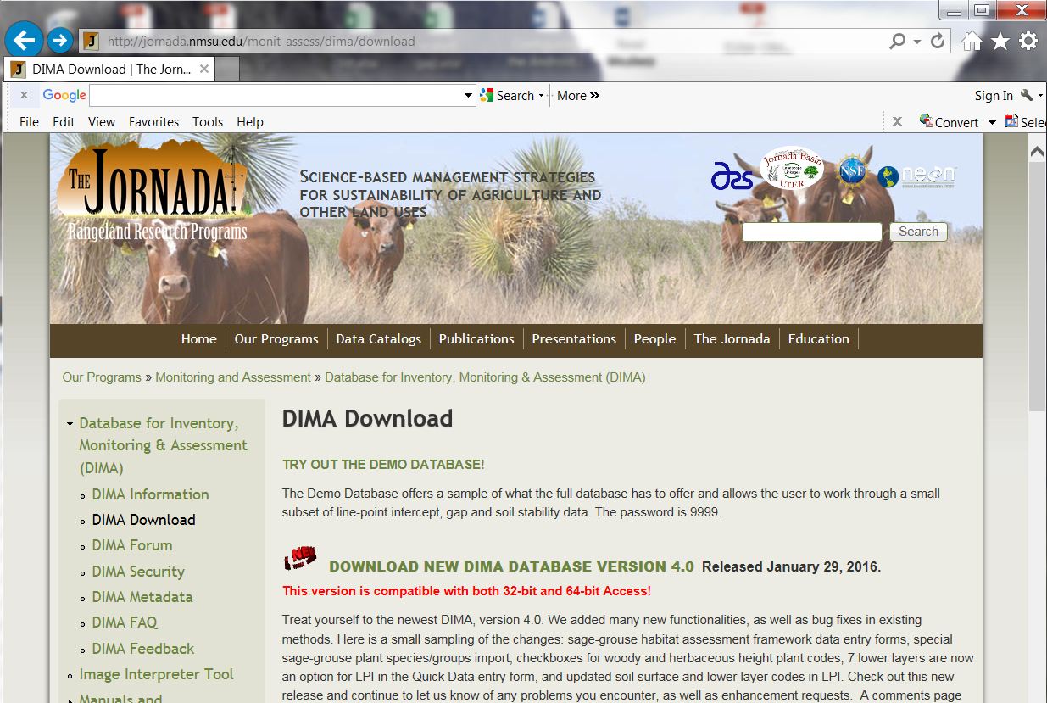
Downloading DIMA
http://jornada.nmsu.edu/monit-assess/dima/download
Check out the DIMA Forum!

Slide 5
DIMA Home Screen

Slide 6
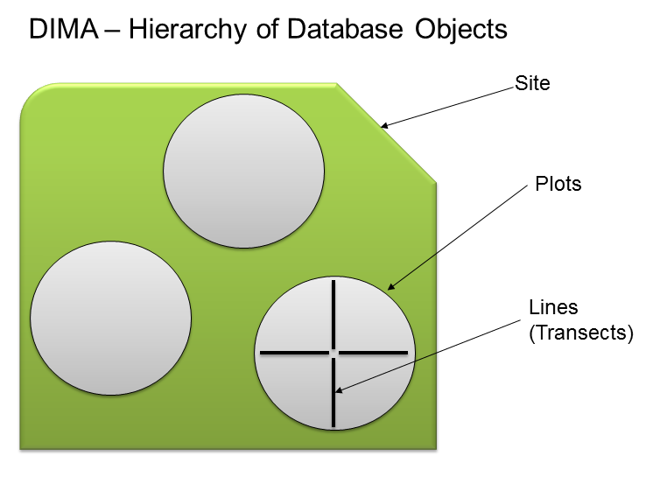
DIMA Structure
Notes:
The way you will need to set up your DIMA is initially by Site. You need to have more than one site and organizing your sites by sample design strata is a good way to keep track of the order of your points within a stratum and helps you keep track of all your points by having an intuitive organization structure. Within each site you will have plots. The name of these plots will need to be the PLOT ID value that was given to you in your sample design. Do not deviate from this naming, exactly, because it is how we track the plots in the larger AIM data structure. Within these plots you will have your transects with LPI and gap data. You will also have species richness and soil stability data.

Slide 7
What we are going to cover today!
Apply AIM settings to method forms in DIMA
Add people and plants
Set up sites and plots
Enter data for AIM methods
Line-point intercept
Gap intercept
Soil stability
Species inventory (species richness)
Sage-grouse habitat

Slide 8
Other Resources
Monitoring Manual
http://www.landscapetoolbox.org/wp-content/uploads/2015/04/MMGSSE_0407.pdf
DIMA Website
http://jornada.nmsu.edu/monit-assess/dima
Landscape Toolbox
http://www.landscapetoolbox.org
http://www.aim.landscapetoolbox.org/ ** this site has a LOT of AIM info and some AIM specific DIMA tutorials

Slide 9
Contact Us
Sarah McCord
smccord@nmsu.edu
575-646-2961
Ericha Courtright
ericha@nmsu.edu
575-646-4147
Nelson Stauffer
ngs@nmsu.edu
575-646-2961
Sarah Burnett
sburnett@blm.gov
303-236-2716

Slide 10
Reporting Errors
Via email or DIMA forum
Version of DIMA
Explain what you did prior to error
If possible, please send screen shot of error message
Welcome to send suggestions and/or feedback

