Slide 1

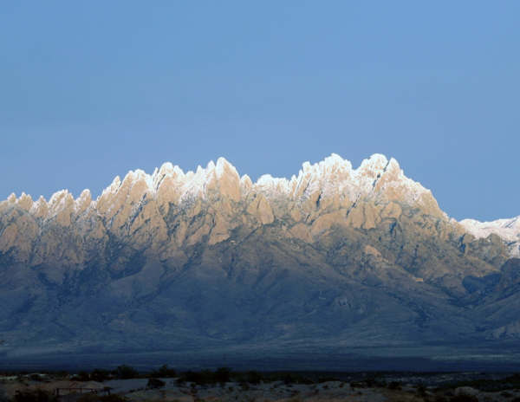


ART & SCIENCE AT THE PLANT-ANIMAL INTERFACE
Using animal behaviors to accomplish management goals
RGSC 294 & RGSC 317
April 7,2014
JER
Notes:
Today you are going to hear about the art in using animal behavior to accomplish management goals and some of the methodologies that can be employed.

Slide 2
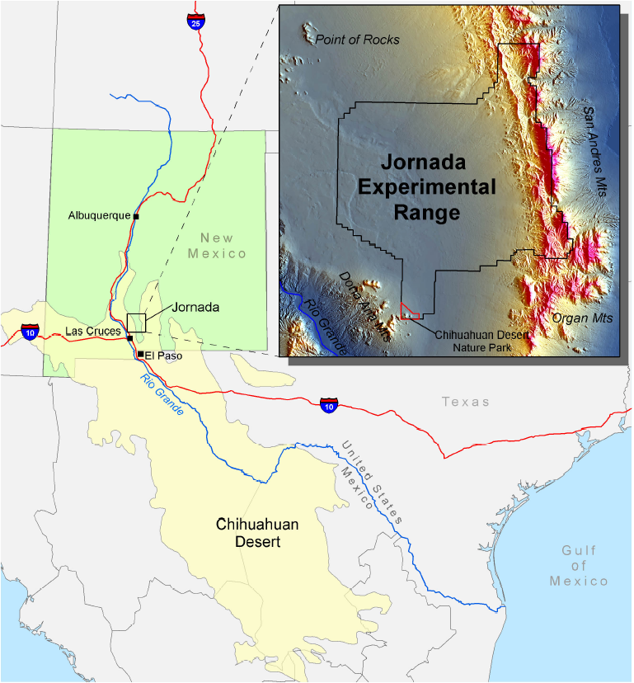
Dean M. Anderson
Research Animal Scientist
US Department of
Agriculture – Agricultural
Research Service
(USDA-ARS)
Jornada Experimental Range
(JER)
JER
Notes:
If you are like me when I go to a meeting I always want a little background on the person I am listening to in order to know if they are an expert. Now for those of you who do not know the defination of an expert, “x” in science generally stand for an unknown quantity and a “spert” is usually a drip under pressure, so this is who you have invited to speak to you and I do thank your for this opportunity. OK, now that we have broken the ice lets begin. Since 1977 I have been with the US Department of Agriculture –Agricultural Research Service as a Research Animal Scientist on the 193,000 acre Jornada Experimental Range located outside Las Cruces, New Mexico about an hours drive north of El Paso, Texas. This research location is located in the largest desert in North America, the Chihuahuan Desert. Our annual precipitation is about 9” with the 52% that falls between July August and September coming from intense, convective thunderstorms that are highly localized and of short duration. The JER represents about 40% of ARS’s land holdings in the United States. The history of the JER dates to the early 1900’s. Up until 1983 the main research thrust of the JER focused brush management and grazing use of this this semidesert grassland with cattle, then in 1983 sheep were introduced into the research program. For a complete picture of the history of the JER I would encourage you to go to usda-ars.nmsu.edu on the web and browse through the past, present and future research directions. Before moving on to the talk even though the JER research is actively involved in free-ranging animal ecology research we do not have any small ruminants on the facility at the present time.

Slide 3
http://Jornada.nmsu.edu
Dean Anderson
JER

Slide 4

LOW-STRESS ANIMAL HANDLING
SLOWER IS FASTER – ONE OF THE KEYS TO WORKING ANIMALS
JER

Slide 5

ANOTHER KEY – GOOD RESOURCES
Arnold, G.W., and Dudzinski, M.L. 1978. Ethology of free-ranging
domestic animals. Elsevier: New York, NY.
Smith, B. 1998. Moving ‘em a guide to low stress animal handling.
The Graziers Hui: Kamela, HI.
On line sources such as:
http://www.animalbehaviour.net
JER

Slide 6
JUSTIFICATION FOR
21st CENTURY ANIMAL BEHAVIOR RESEARCH
What are the rea$ons for doing the research?
Will the data be valuable to resource managers?
Is the team appropriate for reaching the goal?
4. …
JER

Slide 7
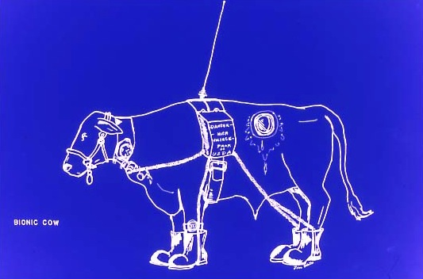
Always ask yourself – How has the
observer influenced the observation?
JER

Slide 8
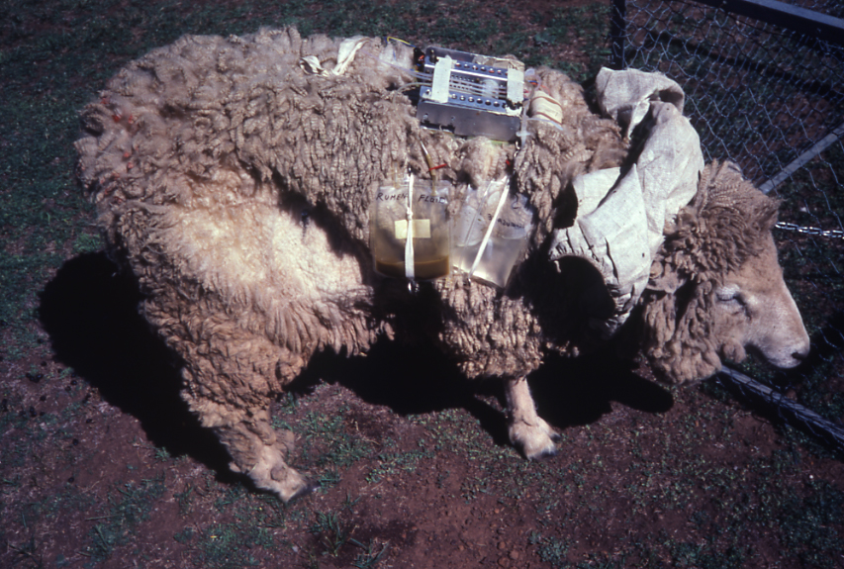
JER

Slide 9
TAKE HOME LESSON
USE INNATE ANIMAL BEHAVIORS TO PRO-ACTIVELY MANAGE
BLEND ART AND SCIENCE TO ACCOMPLISH 21st CENTURY GOALS
THINK OUTSIDE OF THE BOX
JER

Slide 10
CAPTURING COW LIVEWEIGHT DATA AUTONOMOUSLY
JER

Slide 11
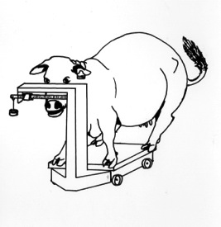
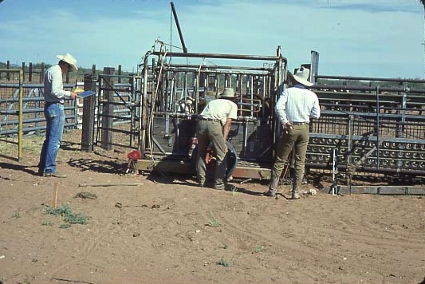
Automated monitoring of cow liveweight
JER

Slide 12
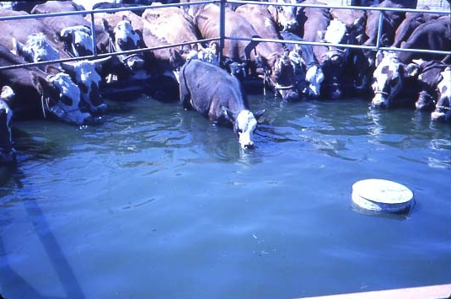
Animals have physiological requirements
JER

Slide 13
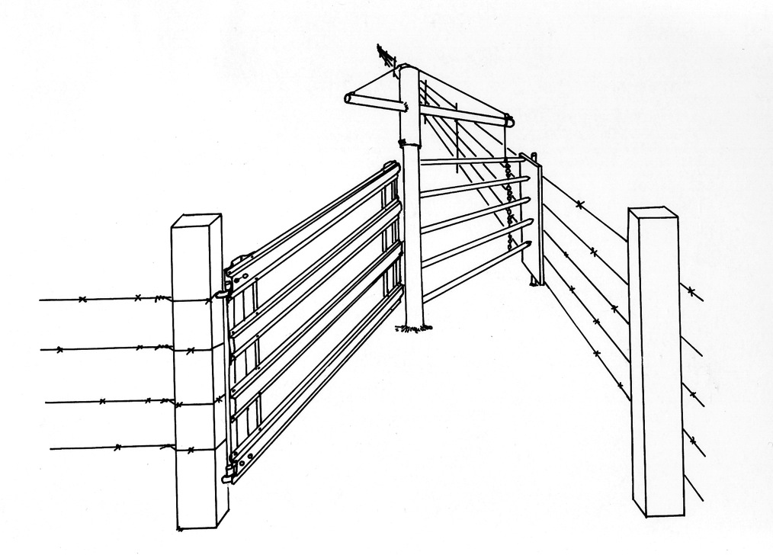
Single bayonet gate
JER

Slide 14
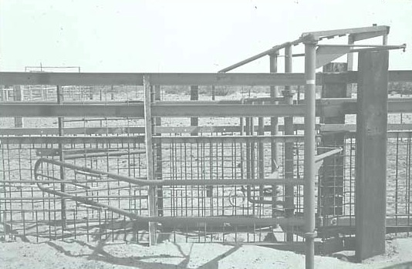
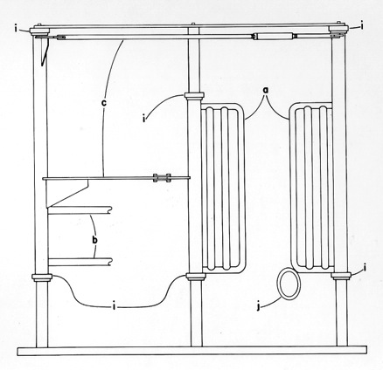
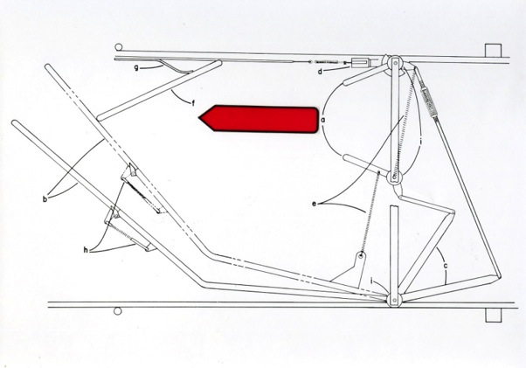
A cow spacer
JER

Slide 15
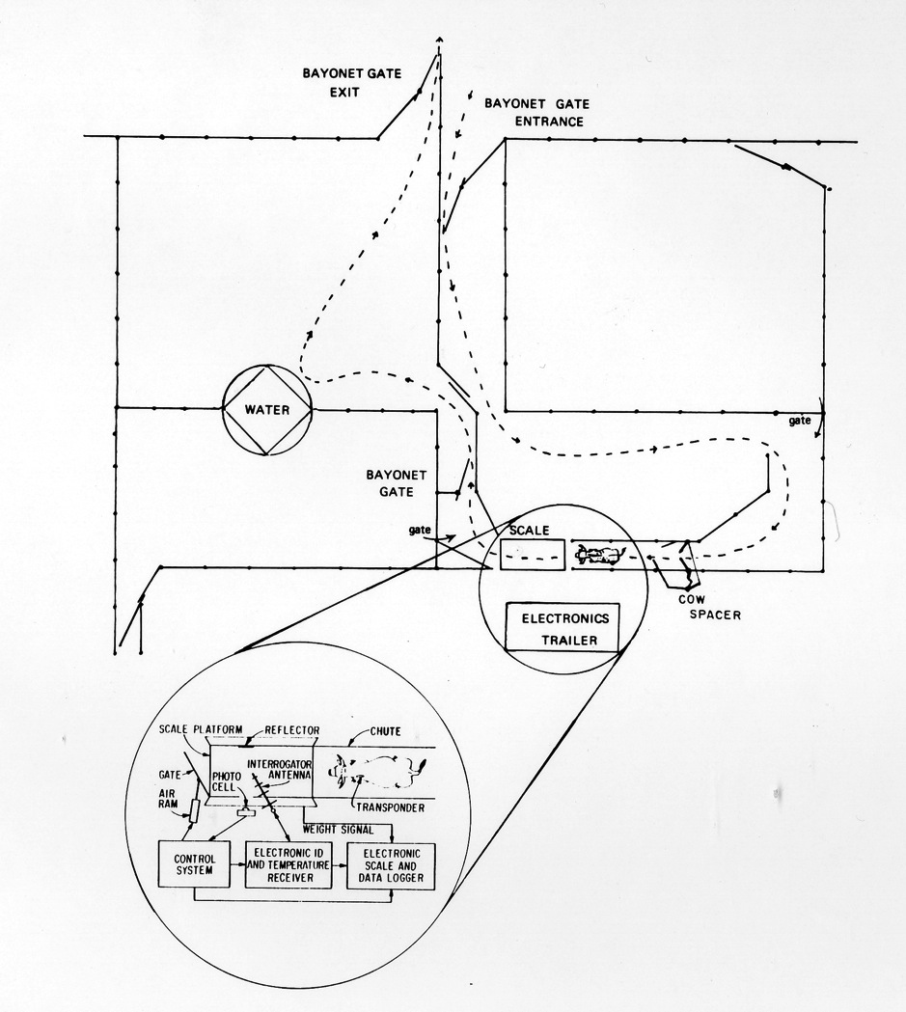
Automatic weighing
JER

Slide 16
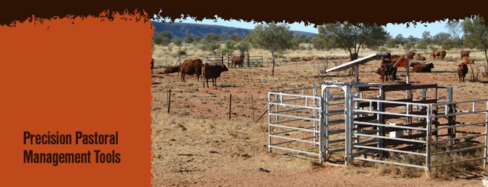
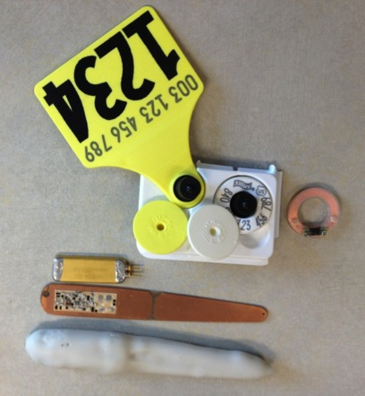
From 1968 to 1989 to 2014
http://crc-rep.com/
http://www.cattletags.com/
$3.50
JER

Slide 17
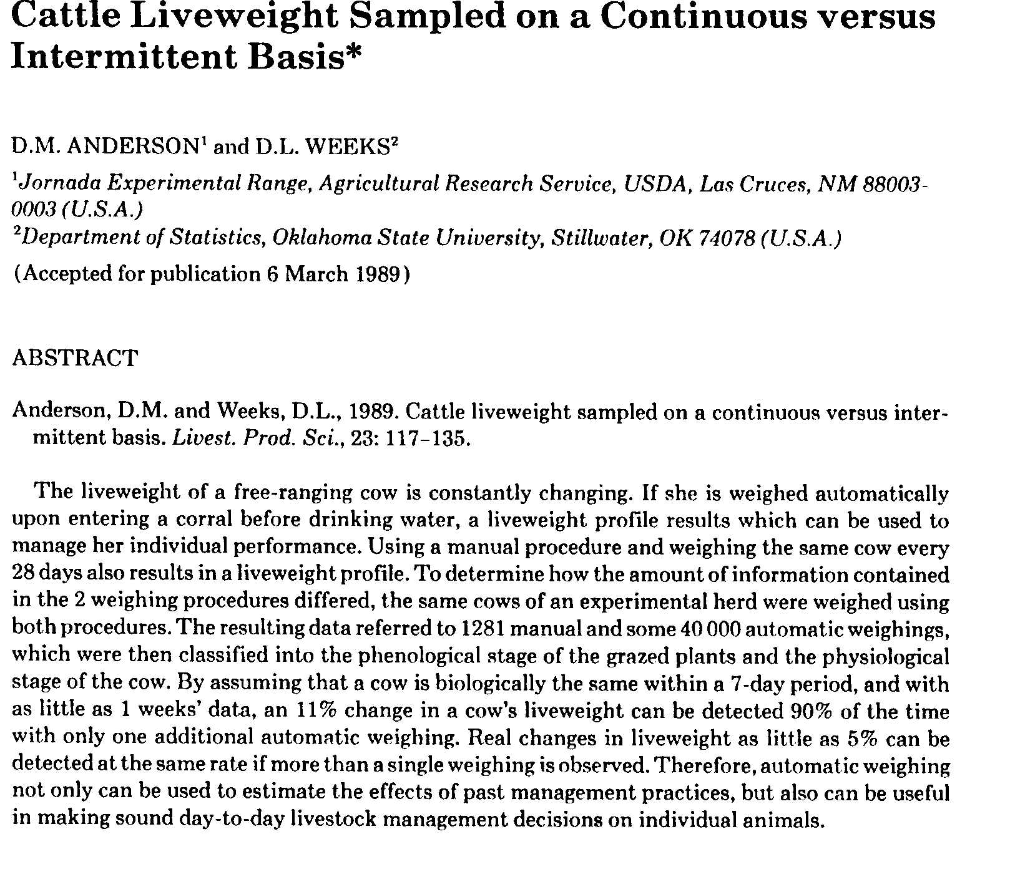
JER

Slide 18
UNDERSTANDING ETHOLOGY TO FACILITATE MIXED-SPECIES STOCKING
JER

Slide 19
ETHOLOGY - The biological study of animal behavior … in relation to an animal’s natural way of live and environment.
Adapted from: Immelmann, K. and Beer, C. 1989. A dictionary of ethology. Harvard University Press, Cambridge, MA.
JER

Slide 20
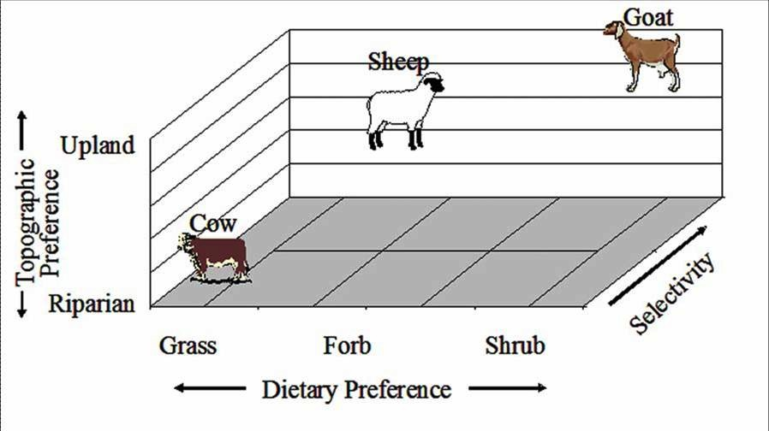
BACKGROUND
ANIMALS PREFER – DIFFERENT DIETS
JER
http://www.cnr.uidaho.edu/rx-grazing/handbook/Chapter_6_Targeted_Grazing.pdf

Slide 21
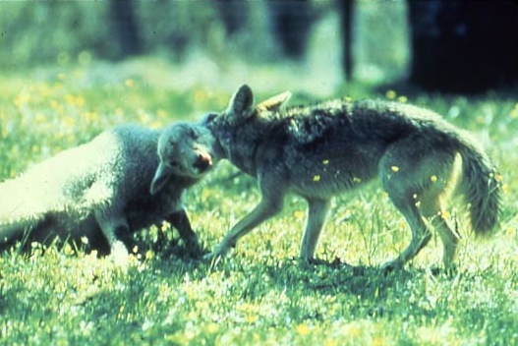
Challenges with mixed-species husbandry
JER

Slide 22

IN 1983
SHEEP WERE INTRODUCED TO THE JORNADA
DURING THE SECOND HALF OF THE FIRST YEAR COYOTES KILLED 44% OF THE SHEEP
Source: Hulet, C. V., Shupe, W. L. and Howard. V. W. 1987. Coyotes, guard dogs, and electric fences. Rangelands. 9(3):102-105.
http://www.bumperart.com/ProductDetails.aspx?SKU=2004111003&productID=19879
JER
Notes:
There were many species of plants that were not being utilized by our cattle and this is why we introduced small ruminants onto the JER

Slide 23
METHODS OF CONTORL
TRAPS AND SNARES
POISONED BAITS
CALLING AND SHOOTING
AERIAL GUNNING
ELECTRIC FENCES
GUARD DOGS
JER

Slide 24
JORNADA OBSERVATIONS
.. CATTLE DON’T “APPRECIATE” CANINES
.. COYOTES DON’T KILL HEALTHY COWS AND CALVES
.. CATTLE AND SHEEP DON’T REMAIN TOGETHER UNDER FREE-RANGING CONDITIONS
JER

Slide 25
HOW FREE-RANGING SMALL RUMINANTS (R^{S}) & CATTLE (C) DISTRIBUTE THEMSELVES OVER A LANDSCAPE
R^{S}
R^{S}
R^{S}
R^{S}
R^{S}
R^{S}
R^{S}
R^{S}
Not together
C
R^{S}
FLOCK
C
C
C
C
R^{S}
C
C
C
C
R^{S}
R^{S}
C
C
C
C
C
C
R^{S}
C
C
C
C
C
R^{S}
R^{S}
C
C
C
C
C
C
C
C
C
C
C
C
C
C
R^{S}
C
C
C
C
HERD
FLERD
JER

Slide 26

WOULD THERE BE A WAY TO GET SHEEP
TO CONSISTENTLY REMAIN CLOSE TO
CATTLE UNDER FREE-RANGING
CONDITIONS, AND IF SO WOULD
THIS ASSOCIATION REDUCE COTOTE
PREDATION?
JER

Slide 27

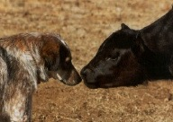
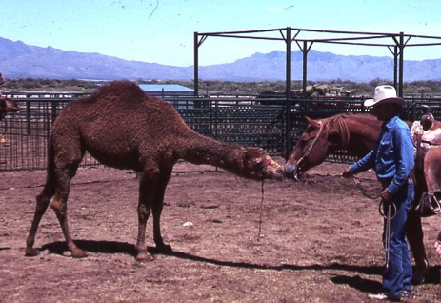
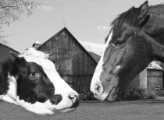
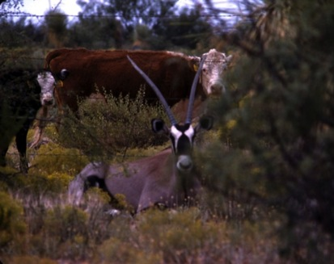
BONDING IS SOCIALIZING ANIMALS OF DIFFERENT SPECIES
http://www.flickr.com/photos/baalands
/sets/72157613483080347/
http://www.betterphoto.com/gallery/dynoGall2.asp?catID
=145&pageID=25&rows=12&contestCatID=&camID=
http://www.betterphoto.com/gallery/dynoGall2.asp?catID=
145&pageID=15&rows=12&contestCatID=&camID=
JER

Slide 28
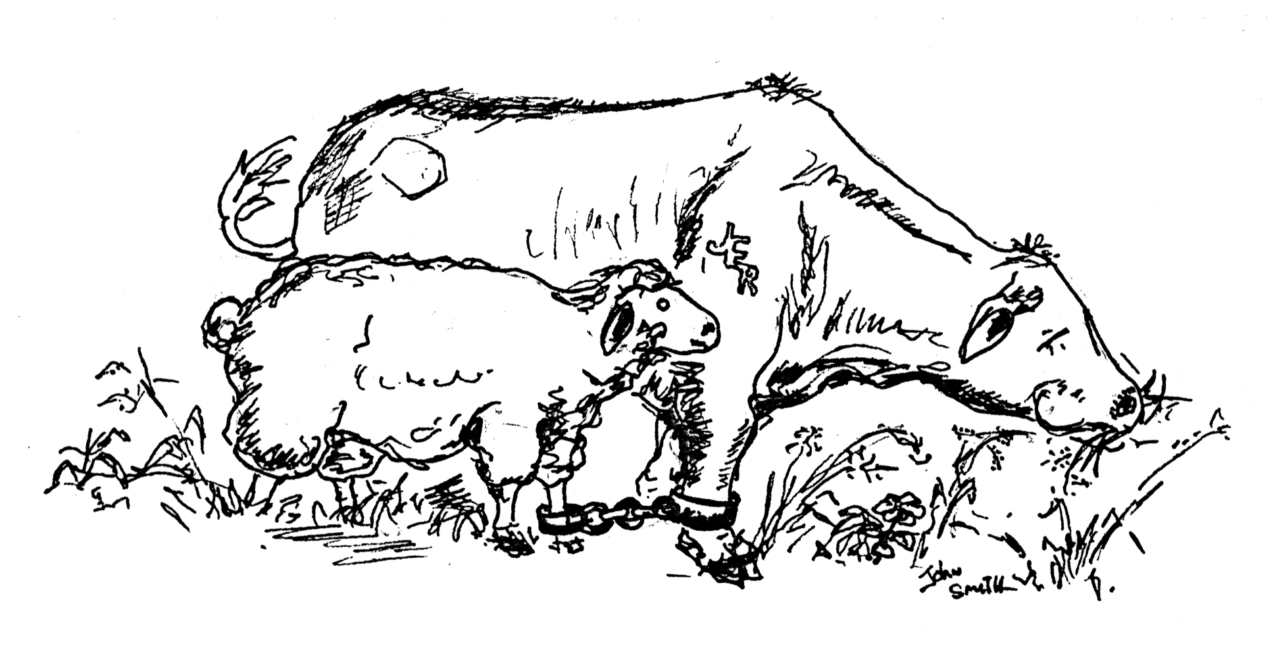
SO WHAT IS A BONDED SHEEP?
JER
Notes:
All talks should begin by defining terms that may be new or used in a different way so let us begin

Slide 29
A bonded small ruminant refers to an animal that has had its behavior modified so it remains in the presence of cattle under free-ranging conditions.
(for a formal definition of cross-specific attachment formation see Hafez 3rd Edition 1975 page 280)
JER
Notes:
All talks should begin by defining terms that may be new or used in a different way so let us begin

Slide 30
WHEN WE PENNED LARGE AND SMALL RUMINANTS TOGETHER
WHAT WORKED
JER

Slide 31
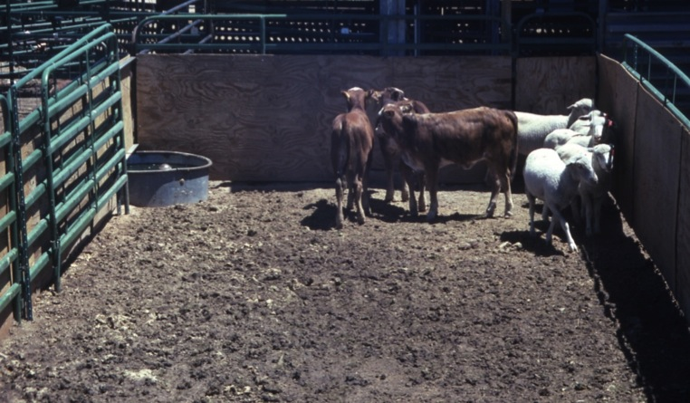
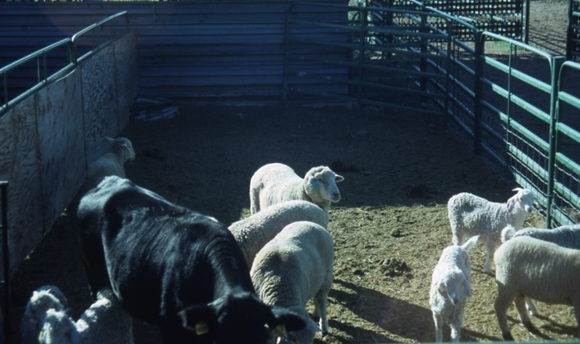
LARGE AND SMALL RUMINANTS CONSISTENTLY ASSOCIATED WITH EACH OTHER
JER

Slide 32
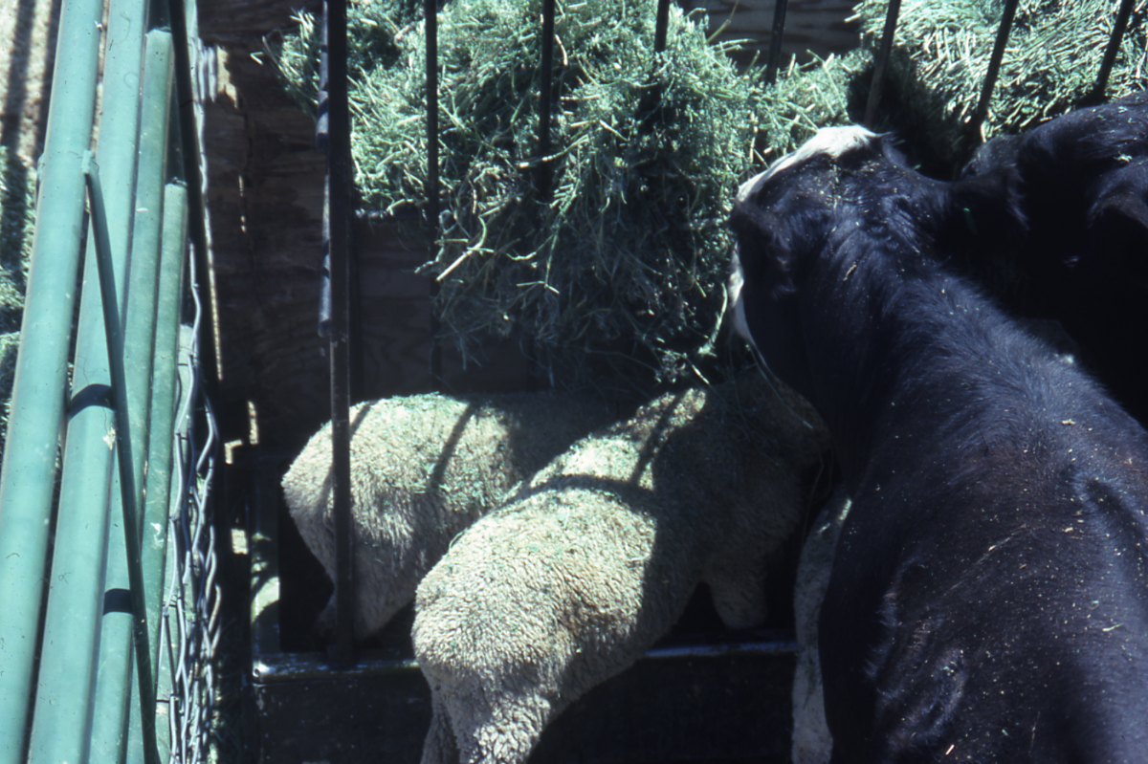
ESPECIALLY DURING FEEDING
JER

Slide 33
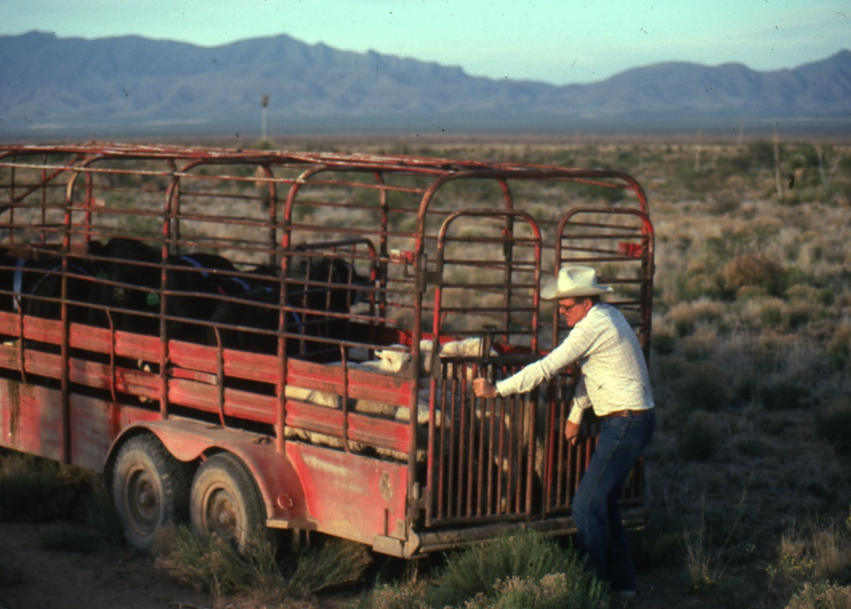
THEN WHEN TAKEN TO THE FIELD
JER

Slide 34
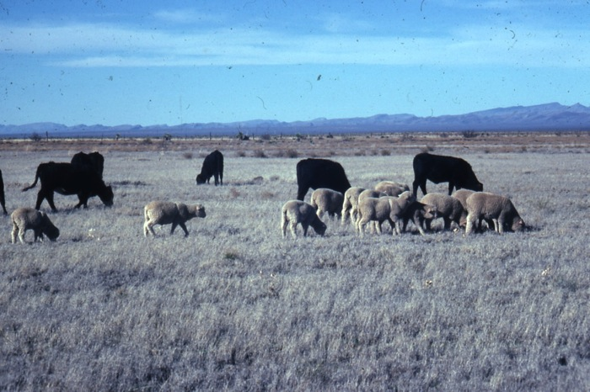
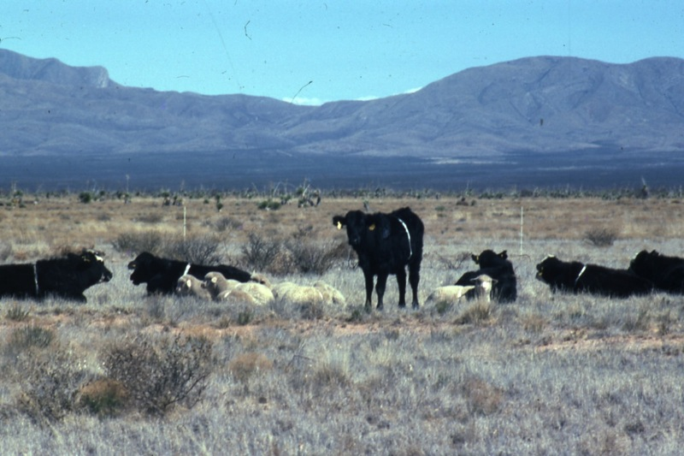
THE ANIMALS CONSISTENTLY STAYED TOGETHER
JER

Slide 35
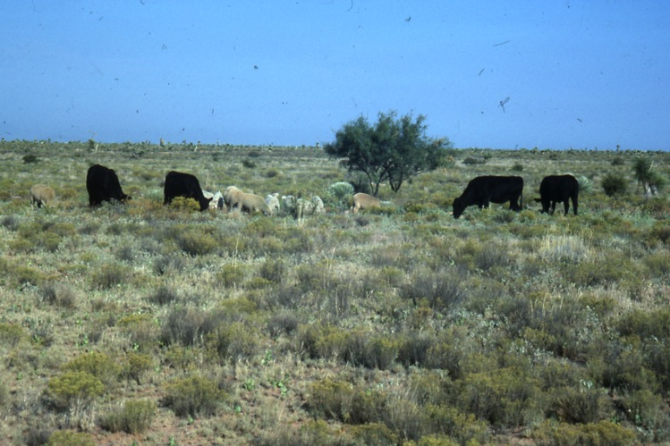
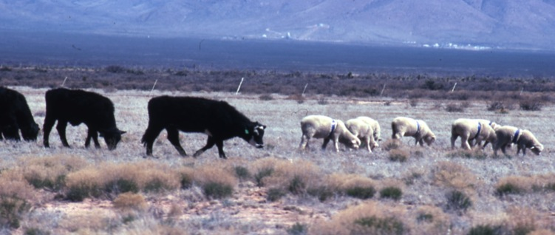
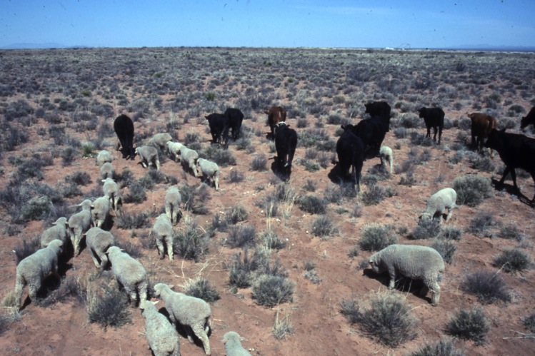
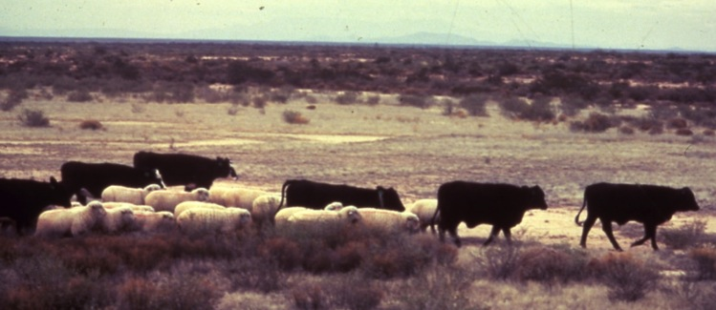
THE GENERAL CONFIGURATION WAS
JER

Slide 36
SO WHAT DO WE CALL THIS GROUP OF ANIMALS THAT BEHAVE DIFFERENTLY THAN A FLOCK AND HERD?
FLERD IS A CONTRACTION OF
FLOCK AND HERD
AND REFERS TO A GROUP OF
BONDED SMALL RUMINANTS
THAT CONSISTENTLY
REMAIN NEAR CATTLE UNDER FREE-
RANGING CONDITIONS
JER
Notes:
As with any discipline animal behavior (ethology) uses terms that might not be common to everyone so let us begin with some working definations.

Slide 37
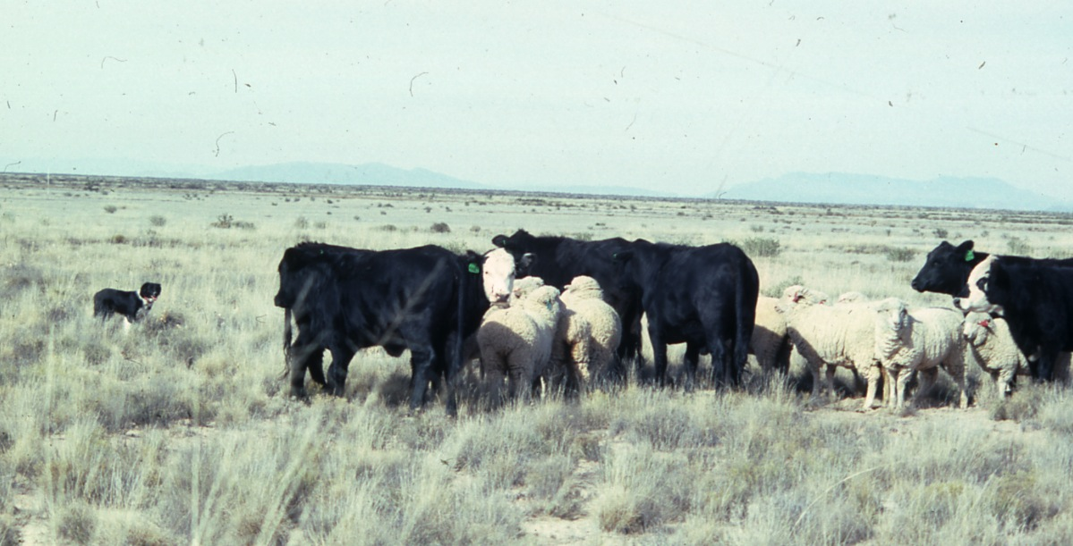
WHAT A FLERD LOOKS LIKE WHEN FACING A CANINE THREAT
JER

Slide 38
WHEN WE PENNED LARGE AND SMALL RUMINANTS TOGETHER
WHAT DID NOT WORK
JER

Slide 39
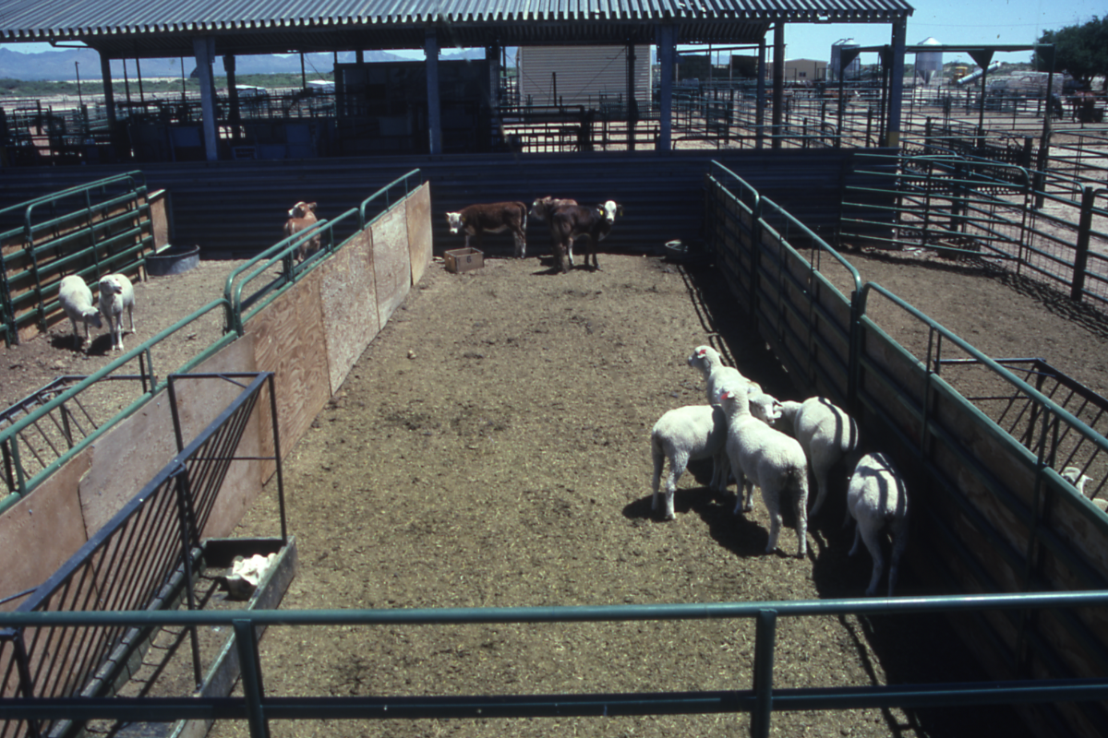
FREQUENT SPATIAL SEPERATION
JER

Slide 40
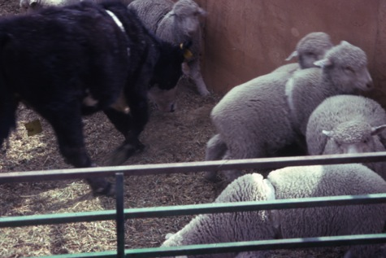
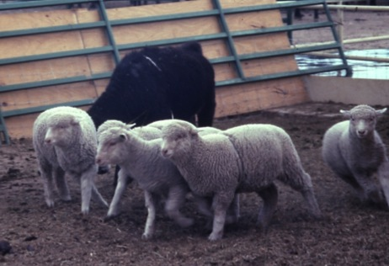
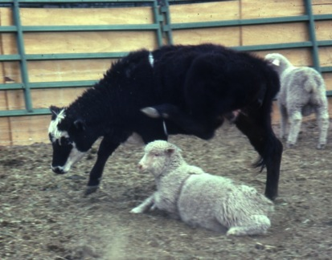
PHYSICAL ABUSE
JER

Slide 41
A FEW WORDS ABOUT FIELD-BONDING
START WITH A CORE BONDED FLERD GROUP MAINTAINED IN A “SMALL” BRUSH-FREE PADDOCK WITH ONLY ONE DRINKING WATER LOCATION, i.e., THINK THROUGH DAILY ROUTINES
STIMULATE ALL THE SENSES, FOR EXAMPLE USE BELLS ON BOTH LARGE AND SMALL RUMINANTS TO KEEP THE GROUP AWARE OF EACH OTHERS LOCATION
USE A TRAINED CANINE TO MOVE THE SEPARATED SMALL RUMINANTS TO THE LARGE RUMINANTS IF SMALL RUMINANTS STRAY “TOO FAR” FROM CATTLE
OBSERVE AND PRO-ACTIVELY MANAGE IMMEDIATELY WHEN “CHALLENGES” ARE OBSERVED
JER

Slide 42
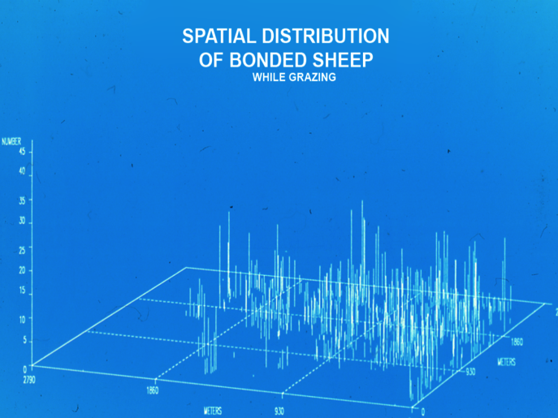
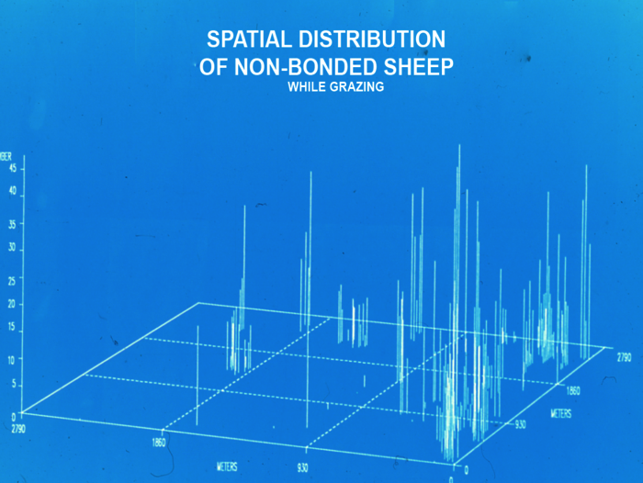
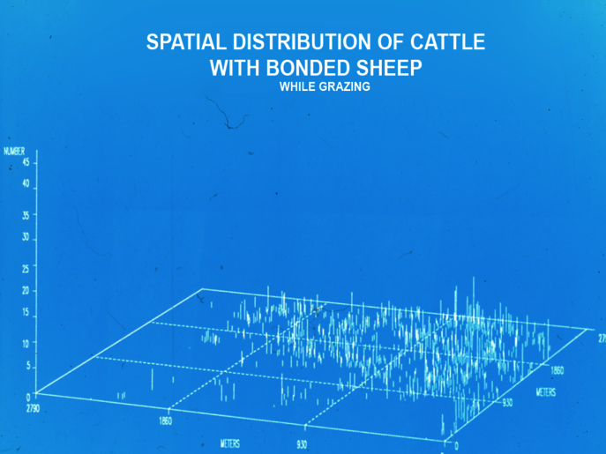
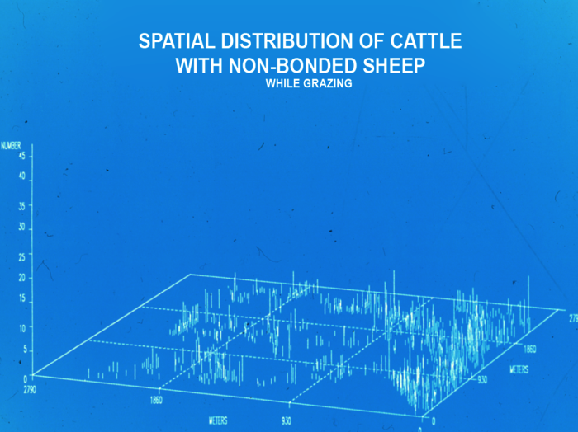
=
=
JER

Slide 43
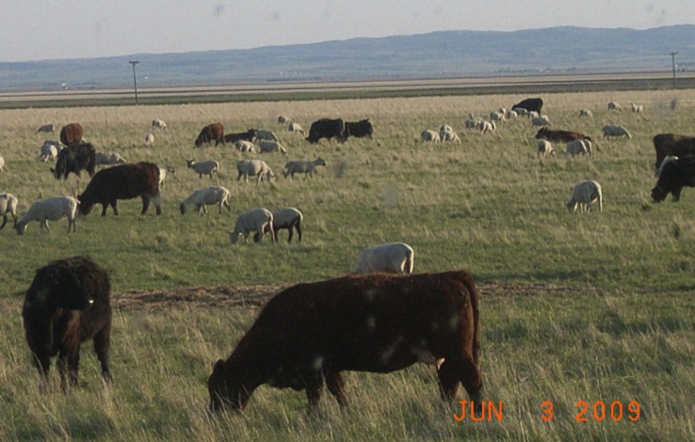
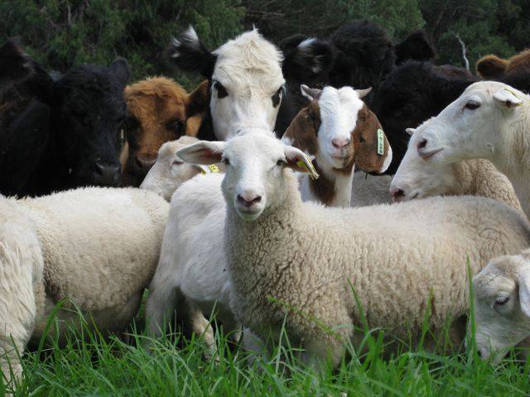
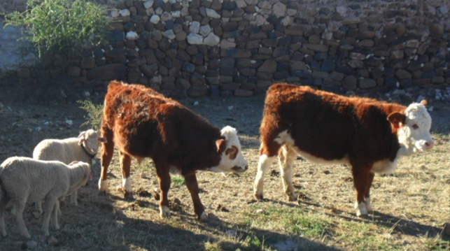
COMMERCIAL FLERDS
Rouleau, Saskatchewan Canada:
Len Larsen Ranch
Maui, Hawaii:
Haleakala Ranch
Northern Cape South Africa:
Doornbult Farm
JER

Slide 44
CONCLUSIONS
FLERDS HAVE A PO$ITVE INFLUENCE ON:
PREDATION
MANAGEMENT/HUSBANDRY
LANDSCAPE ECOLOGY
FENCING REQUIREMENTS
JER

Slide 45
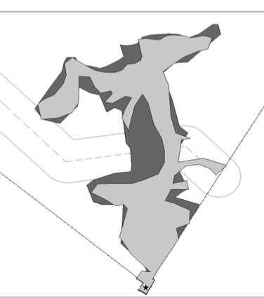
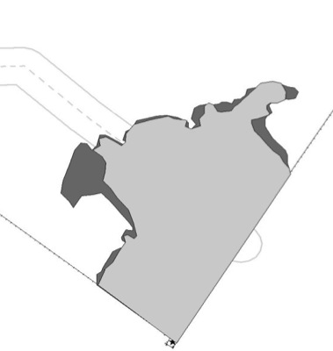
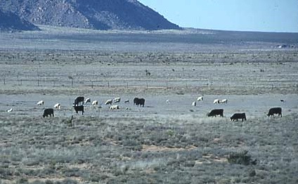
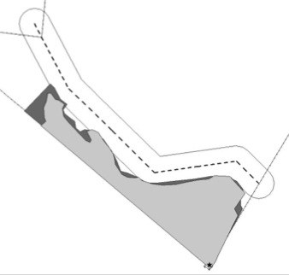
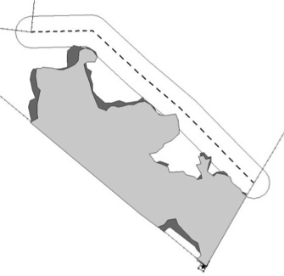
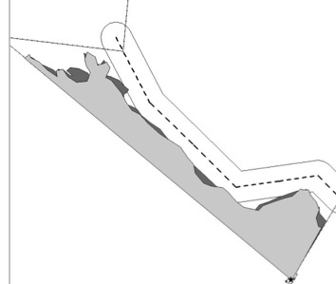

CONTROLLING CATTLE AND BONDED SHEEP USING DVF™
Pre-cuing
Post-cuing
cattle
sheep
A FREE-RANGING FLERD
Cuing
Cuing
Cuing
Cuing
JER

Slide 46
Managing livestock using animal behavior: mixed-species stocking and flerds
D. M. Anderson¹, E. L. Fredrickson² and R. E. Estell¹
¹USDA-ARS-Jornada Experimental Range, P.O. Box 30003 MSC 3JER, Las Cruces, NM 88003, USA; ²Department of Agriculture, Eastern Kentucky University, Richmond, KY 40475, USA
(Received 15 June 2011; Accepted 16 December 2011; First published online 10 February 2012)
Animal (2012), 6(8), 1339–1349.
Mixed-species stocking can foster sound landscape management while offering economic and ecological advantages compared with mono-species stocking. Producers contemplating a mixed-species enterprise should reflect on several considerations before implementing this animal management strategy. Factors applicable to a particular producer’s landscape must be considered together with goals and economic constraints before implementing mixed-species stocking. A major consideration when using mixed-species stocking is how to deal with predation losses, especially among small ruminants. An approach being adopted in some commercial operations capitalizes on using innate animal behaviors to form cohesive groups of two or more livestock species that consistently remain together under free-ranging conditions. These groups are referred to as flerds. The mixing of a flock of sheep and/or goats with a herd of cattle into a flerd has been shown to protect sheep and goats from coyote predation, as well as offering other husbandry advantages. Some of the added advantages include more efficient conversion of forage into animal protein. Creation of flerds, their maintenance and advantages are discussed.
Keywords: livestock, bonding, predation, animal behavior
JER

Slide 47

VIRTUAL FENCING TO CONTROL AND GATHER ANIMALS
It began with
Richard M Peck’s
August 1973 Patent
http://www.invisiblefence.com/our-company/company-history
JER

Slide 48

Conventional Fences Are:
Uneconomical to build and maintain
Undesirable aesthetically to some persons
Inflexible for managing herbivory, especially on heterogeneous landscapes
Challenging to the free movement of some wildlife
Static, yet are used to manage dynamic resources!
JER

Slide 49
Is Conventional Fencing Adequate?
It depends
  Yes, for absolute animal control
  No, for resource management
  Legal boundary demarcation
  ...
  Plants and animals are dynamic
  ...
JER

Slide 50
After Control What Are We Attempting To Accomplish With Fencing?
“Next to proper stocking, distribution of stock on the range
is the most important feature of range management.”
1919
Jardine and Anderson
92 YEARS & COUNTING
“Uneven use of rangeland by livestock continues to be a major problem . . . “
2011
Holechek, Pieper, and Herbel
JER

Slide 51

Everything we do to animals teaches “something” – the choice is ours on what we want them to learn. Bottom line - animals respond to cues
Illustration by Don Trawin, Saturday Evening Post. 2000. (6)272:50-51
JER

Slide 52

SOME BEHAVIOR BASICS –
Around Every Animal Exists Three Zones
WHEN THE FLIGHT ZONE IS PENETRATED MOVEMENT OCCURS
Recognition
Flight
Fight
“A DYNAMIC BAND”
For details see Smith, B. 1998. Moving ’ em – A guide to low stress animal handling. The Graziers Hui, Kamuela, HI.
JER
J&zTi=1&sdn=webclipart&cdn=compute&tm=11&gps=325_429_1516_777&f=00&tt=14&bt=0&bts=0&zu=http%3A//classroomclipart.com/cgi-bin/kids/imageFolio.cgi%3Fdirect%3DClipart/Animals/Cow_Clipart

Slide 53

The Recognition Zone
JER

Slide 54

The Recognition – Flight Zone Boundary
JER

Slide 55

The “Correct” Response
JER

Slide 56
There Can Be Another Response
JER

Slide 57
Can you accept “leaky” boundaries?
If the health or safety of either humans or animals must not be compromised,
… Do Not Use Virtual Fencing
JER

Slide 58


SO WHAT IS VIRTUAL FENCING?
3 grams
Telemetry Solutions | 5051 Commercial Circle, Suite A, Concord, CA 94520 | +1(925) 798-1942
JER

Slide 59

Directional Virtual Fencing (DVF™)
Theory of operation
Key : (+) Indicates increasing intensity
1 = Virtual Boundary (VB™), 200 m wide
2 = Virtual Paddock (VP™) with animals
3 = (+) sound only
4 = (+) sound & (+) electrical stimulation
5 = (++) sound & (++) electrical stimulation
6 = (+++) sound & (+++) electrical stimulation
7 = VP™ without animals
8 = Virtual Center Line (VCL™)
9 = Angle of approach to VCL™
9
7
8
6
6
+100
5
4
1
0
3
-25
-50
2
-75
-100
JER

Slide 60


Holding Animals
Tame pasture
Rangeland
JER

Slide 61
Holding A Cow Behind A Static Virtual Boundary (VB™)
Pre-Cuing Cuing Post-Cuing
1
0
B
1
0
B
1
0
B
1
1
4
h
a
6
9
h
a
Ú
Ê
Ú
D
Ê
r
i
n
k
i
n
g
W
a
t
e
r
D
r
i
n
k
i
n
g
W
a
t
e
r
V
i
r
t
u
a
l
c
e
n
t
e
r
l
i
n
e
(
V
C
L
)
T
M
Z
o
n
e
6
2
0
0
m
w
i
d
e
v
i
r
t
u
a
l
b
o
u
n
d
a
r
y
(
V
B
T
M
)
5
M
a
x
i
m
u
m
a
r
e
a
o
c
c
u
p
i
e
d
b
y
c
o
w
1
0
h
a
4
B
a
r
b
e
d
w
i
r
e
f
e
n
c
e
N
Ú
3
Ê
Ê
D
r
i
n
k
i
n
g
W
a
t
e
r
Z
o
n
e
1
2
Ú
W
e
a
t
h
e
r
s
t
a
t
i
o
n
JER

Slide 62






Response Of A Cow To Left Side Audio And Electric Cues
Begin
The six frames were recorded over 15 consecutive seconds on 3/30/00 in Paddock 11B
End
JER

Slide 63

Controlling Cattle In A Moving Virtual Paddock (VP™)
The virtual paddock was programmed to move 1.1 m per hour between 7:00 am
and 5:00 pm
and to otherwise remain static.
JER

Slide 64

JER

Slide 65

Gathering Animals
JER

Slide 66

JER

Slide 67


Flexible Prescription-based management
JER

Slide 68

THE REAL CONCLUSION
PHYSICAL
LABOR
COGNITIVE
LABOR
JER

Slide 69
Submitted to The Rangeland Journal
March 7, 2014
JER

Slide 70
TAKE HOME LESSON
USE INNATE ANIMAL BEHAVIORS TO PRO-ACTIVELY MANAGE
BLEND ART AND SCIENCE TO ACCOMPLISH 21st CENTURY GOALS
THINK OUTSIDE OF THE BOX
JER

Slide 71
http://Jornada.nmsu.edu
Dean Anderson
JER

Slide 72

STRETCH YOURSELF – THINK OUTSIDE
OF THE BOX
JER

Slide 73
Thank You
For details go to
http://Jornada.nmsu.edu
Contact Information:
Dean M. Anderson
575-646-5190
deanders@nmsu.edu
S. Barrett - Organ Mountains January 21, 2007; 5:15 PM
JER

Slide 74
Disclaimer
Mention of a trade name does not
constitute a guarantee, endorsement,
or warranty of the product by the
USDA-ARS over other products not
mentioned.
JER

