Slide 1
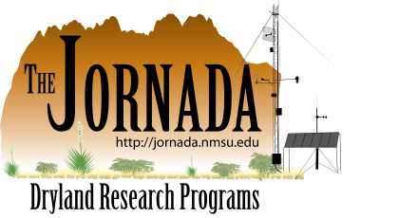

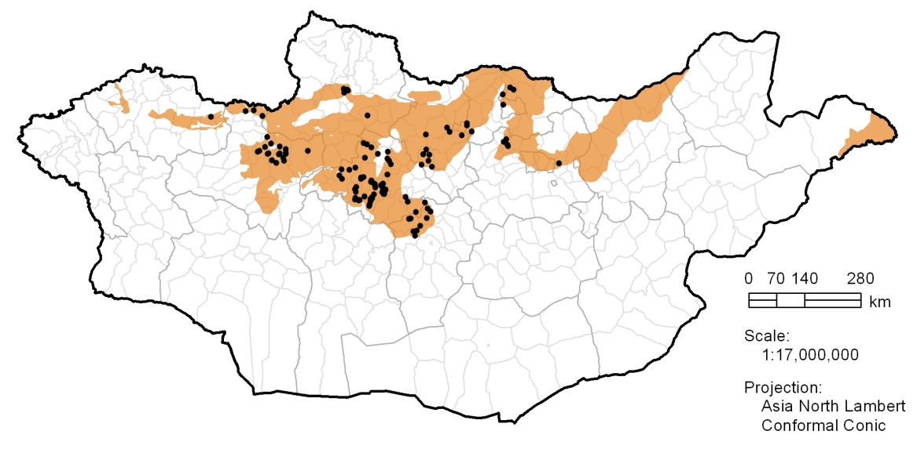
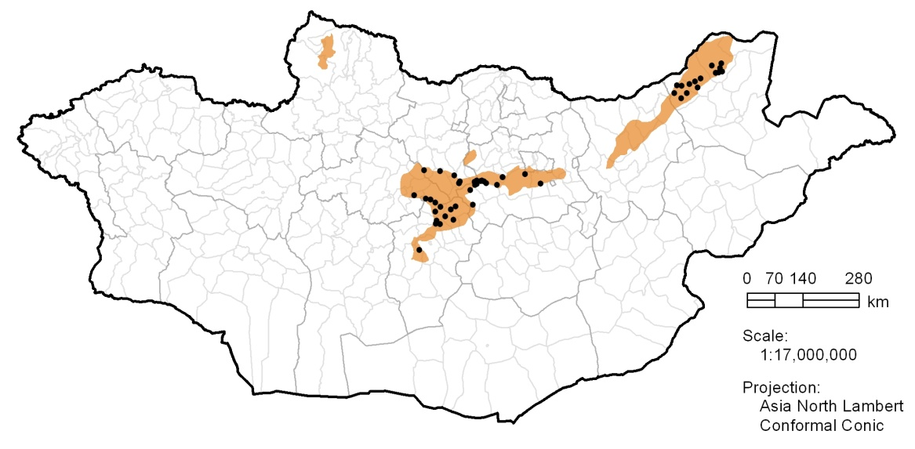
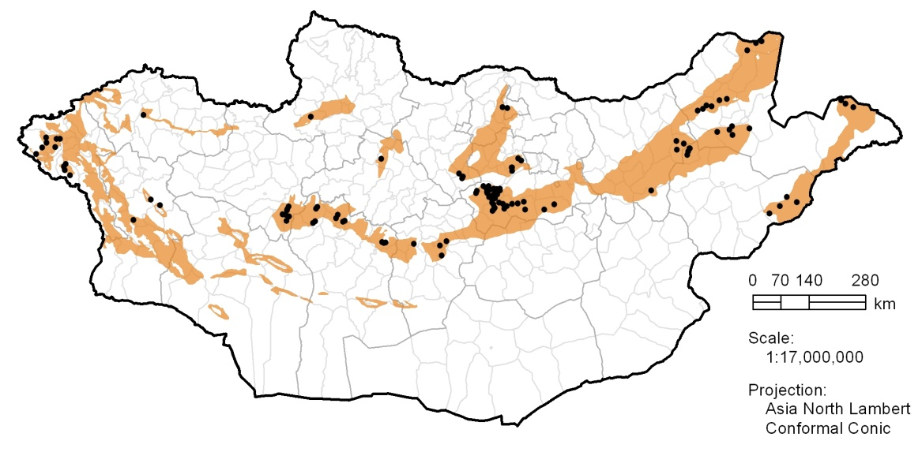
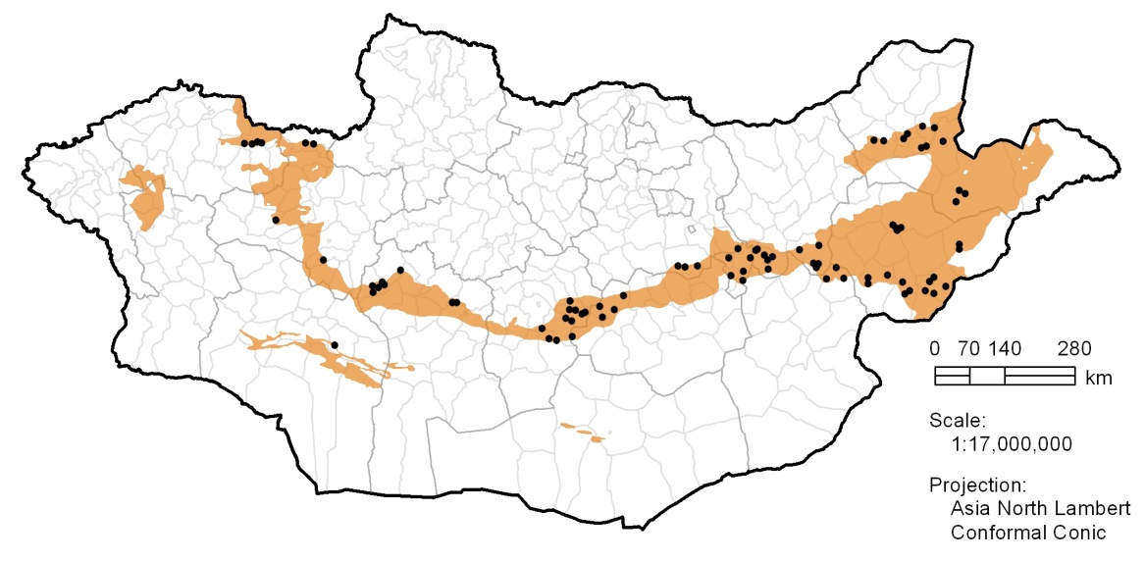
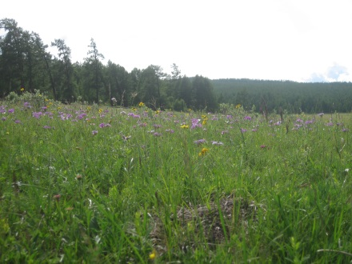
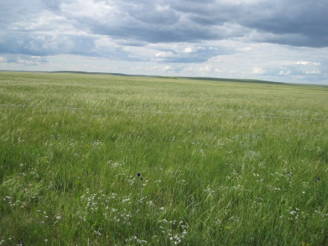
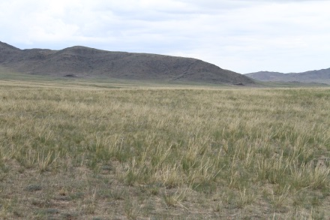
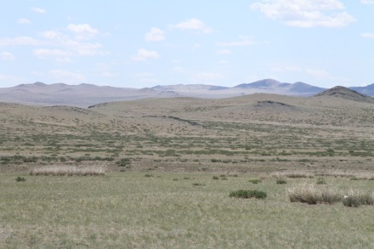
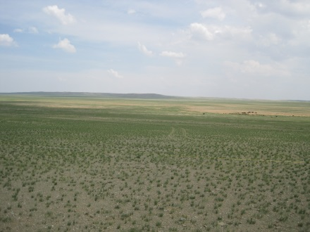
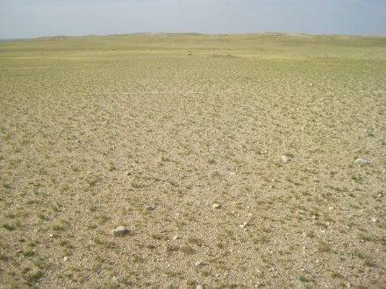
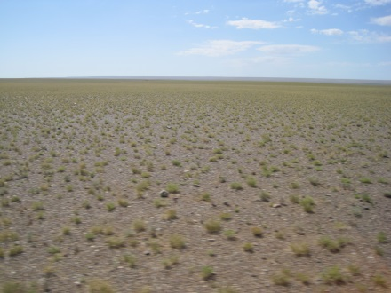
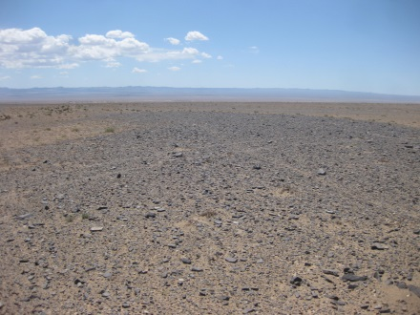
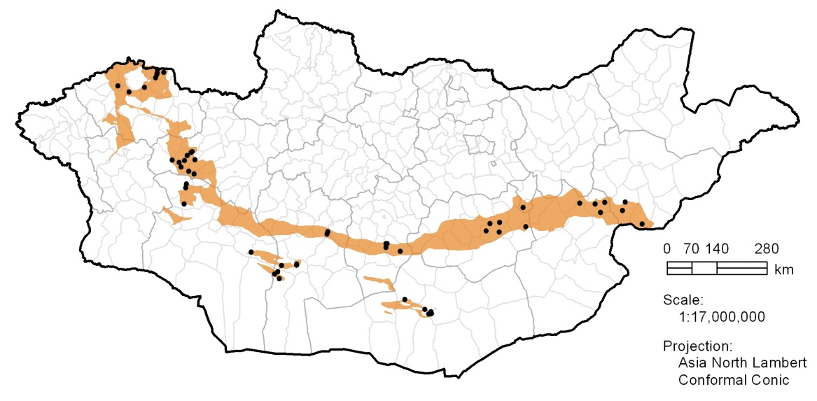
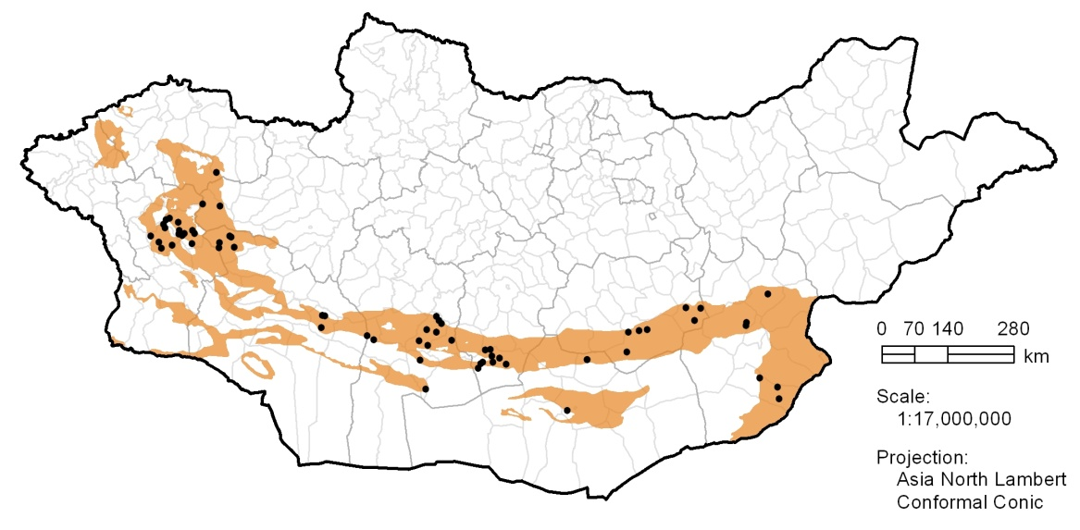
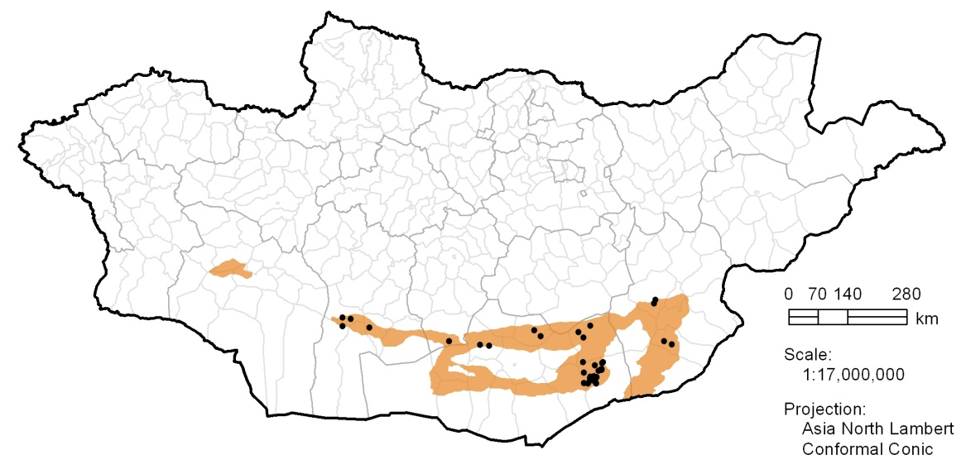
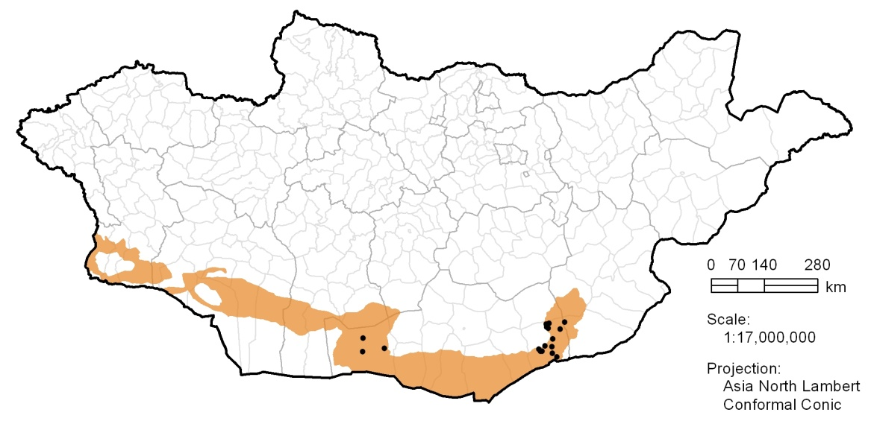
Ecological Site Inventory of Mongolia
A statistical assessment of plant community variation by natural zone
Brandon Bestelmeyer, Jeb Williamson, Densambuu Bulgamaa, Ulambayar Budbaatar, Ankhtsetseg Battur, Justin Van Zee, Ericha Courtwright, Laura Burkett
This analysis utilized field data collected by the SDC Green Gold Project and the Mongolian Society for Range Management.
We thank Maria Fernandez-Gimenez and Jay Angerer for providing access to additional field data.
Description
Documenting and explaining plant community variation using systematic approaches is fundamental to the assessment of land condition and devising sustainable land use practices and policies. This poster presents a statistical approach to characterizing prominent plant community variations within eight natural zones of Mongolia. Hierarchical cluster analysis was used to group ecological inventory sites sharing certain vegetation features, and summary statistics were calculated to determine the plant species most characteristic or diagnostic of each cluster. Each panel below includes a scatter plot showing the cluster membership of sample sites and their distribution along principal coordinates analysis (PCO) axes 1 and 2. Sample sites located close together on the PCO scatter plot can be interpreted as having relatively similar vegetation characteristics. Site dissimilarity was computed using the Bray-Curtis metric, and Ward’s method was used to cluster sites through agglomeration. Each panel also includes a table reporting plant species frequency (first number in each column) and mean foliar cover (in parentheses) within individual clusters. In this case, frequency is defined as the percentage of sample sites supporting a particular species, and mean cover reflects only those sites having greater than zero cover. Species listed here are those having more than 50% frequency in at least one cluster. The next step is to interpret plant community groups according to ecological potential and restoration needs.
Example
Partitioning of Forest Steppe sample sites using hierarchical clustering. Cluster numbers can be increased or decreased to study the different levels of plant community variation within a region.
Cluster number
0
2
3
4
5
6
Oit heeriin bus (Forest steppes)
Nugat heer (Meadow steppe)
Heer (steppe)
Huurai heer (Dry steppes)
 |  | Species frequency and mean cover by cluster
Plant species | Plant species (Mongolian) |  | 1 (n=35) |  | 2 (n=22) |  | 3 (n=15) |  | 4 (n=20) |  | 5 (n=15) |  | 6 (n=6)
Agropyron cristatum | Saman erhug | 91( | 4.7) | 59( | 4.1) | 73( | 3.7) | 90( | 4.0) | 53( | 9.6) | 50( | 2.8)
Allium bidentatum | Shudlig songino | 31( | 3.7) | 14( | 0.5) | 33( | 1.2) | 60( | 2.4) | 13( | 0.5) | 0( | NaN)
Arenaria capillaris | Hyalgasan devhergen tsagaan | 63( | 2.9) | 45( | 2.3) | 67( | 6.2) | 65( | 4.0) | 20( | 1.7) | 0( | NaN)
Artemisia commutata | Hurgan sharilj | 14( | 0.8) | 18( | 2.2) | 60( | 6.7) | 30( | 3.3) | 0( | NaN) | 17( | 5.0)
Arnebia fimbriata | Tsatsagt bereemeg | 14( | 2.8) | 32( | 2.8) | 0( | NaN) | 55( | 6.6) | 0( | NaN) | 17( | 13.2)
Artemisia frigida | Agi | 60( | 5.7) | 36( | 10.0) | 67( | 8.9) | 35( | 3.4) | 33( | 5.2) | 0( | NaN)
Aster alpinus | Tagiin gol geser | 29( | 2.0) | 9( | 2.6) | 53( | 1.9) | 15( | 1.2) | 7( | 0.5) | 33( | 2.4)
Carex duriuscula | Shireg ulalj | 91( | 11.5) | 100( | 44.6) | 33( | 4.6) | 100( | 17.9) | 47( | 7.5) | 33( | 0.6)
Carex korshinskyi | Korjinskiin ulalj | 14( | 3.6) | 5( | 1.5) | 67( | 17.7) | 5( | 0.2) | 13( | 0.9) | 0( | NaN)
Carex pediformis | Zogdor ulalj | 6( | 3.1) | 5( | 0.2) | 7( | 4.0) | 15( | 8.3) | 7( | 4.5) | 100( | 41.5)
Dasiphora fruticosa | Suugun borolzgono | 0( | NaN) | 18( | 4.3) | 13( | 1.1) | 5( | 1.2) | 13( | 7.2) | 67( | 10.4)
Festuca lenensis | Leniin botuuli | 31( | 4.2) | 18( | 0.9) | 67( | 3.0) | 35( | 1.6) | 33( | 8.1) | 33( | 5.0)
Galium verum | Jinhene urumtuul | 17( | 1.5) | 18( | 0.5) | 33( | 2.8) | 40( | 0.9) | 20( | 0.9) | 67( | 5.5)
Koeleria macrantha | Tom tsetsegt daagan suul | 83( | 4.1) | 68( | 1.9) | 100( | 9.0) | 90( | 4.8) | 20( | 5.5) | 67( | 6.2)
Poa attenuate | Sunagar bieleg | 37( | 2.3) | 36( | 1.8) | 60( | 3.6) | 55( | 1.9) | 33( | 1.8) | 67( | 2.1)
Potentilla acaulis | Ishgui gichgene | 57( | 7.3) | 32( | 3.4) | 33( | 8.5) | 60( | 4.1) | 13( | 0.3) | 33( | 10.5)
Potentilla bifurca | Imt gichgene | 43( | 0.8) | 77( | 1.1) | 40( | 1.9) | 45( | 0.7) | 33( | 2.1) | 50( | 1.7)
Pulsatilla turczaninovii | Turchaninoviin yargui | 34( | 2.8) | 23( | 1.4) | 60( | 4.7) | 65( | 2.4) | 13( | 0.4) | 17( | 0.8)
Stipa krylovii | Kryloviin hyalgana | 100( | 34.5) | 41( | 2.6) | 73( | 5.2) | 100( | 10.9) | 60( | 7.0) | 67( | 16.8)
 |  | Species frequency and mean cover by cluster
Plant species | Plant species (Mongolian) |  | 1 (n=11) |  | 2 (n=18) |  | 3 (n=6) |  | 4 (n=7) |  | 5 (n=9)
Agropyron cristatum | Saman erhug | 64( | 1.6) | 83( | 3.4) | 50( | 2.2) | 71( | 3.0) | 89( | 15.9)
Allium bidentatum | Shudlig songino | 45( | 2.6) | 39( | 2.0) | 33( | 1.2) | 57( | 1.1) | 33( | 0.5)
Artemisia adamsii | Adamsiin sharilj | 0( | NaN) | 28( | 9.2) | 33( | 11.4) | 14( | 1.8) | 67( | 11.9)
Arnebia fimbriata | Tsatsagt bereemeg | 0( | NaN) | 6( | 2.4) | 17( | 12.0) | 0( | NaN) | 67( | 6.8)
Artemisia frigida | Agi | 55( | 19.1) | 56( | 6.9) | 33( | 8.9) | 86( | 9.7) | 11( | 12.0)
Caragana microphylla | Byatshan navchit hargana | 45( | 3.8) | 28( | 2.3) | 33( | 11.5) | 57( | 5.4) | 44( | 8.6)
Caragana stenophylla | Nariin navchit hargana | 27( | 2.0) | 33( | 1.1) | 33( | 0.4) | 43( | 1.2) | 56( | 1.8)
Chenopodium album | Tsagaan luuli | 9( | 44.0) | 6( | 4.0) | 67( | 4.1) | 57( | 1.3) | 33( | 1.5)
Cleistogenes squarrosa | Derveen hazaar | 55( | 18.9) | 72( | 11.3) | 50( | 2.8) | 71( | 15.1) | 78( | 1.5)
Carex duriuscula | Shireg ulalj | 18( | 2.0) | 33( | 4.6) | 83( | 8.0) | 29( | 0.8) | 100( | 19.5)
Cymbaria dahurica | Daguur hatnii tsetseg | 55( | 1.4) | 17( | 0.6) | 17( | 1.0) | 14( | 1.0) | 22( | 0.2)
Elymus chinensis | Nangiad tsagaan suli | 100( | 4.4) | 78( | 13.1) | 100( | 22.0) | 43( | 9.2) | 78( | 6.2)
Potentilla bifurca | Imt gichgene | 27( | 0.6) | 17( | 0.3) | 50( | 1.4) | 14( | 0.5) | 56( | 1.0)
Salsola collina | Tolgodiin budargana | 9( | 2.0) | 6( | 1.0) | 33( | 8.9) | 71( | 9.4) | 0( | NaN)
Serratula centauroides | Hongor zullig hongorzalaa | 18( | 3.1) | 11( | 0.2) | 17( | 0.8) | 57( | 3.0) | 0( | NaN)
Stipa krylovii | Kryloviin hyalgana | 100( | 29.0) | 100( | 50.7) | 67( | 5.2) | 86( | 6.8) | 100( | 16.1)
Thymus gobicus | Goviin ganga | 0( | NaN) | 0( | NaN) | 0( | NaN) | 57( | 1.7) | 11( | 9.0)
 |  | Species frequency and mean cover by cluster
Plant species | Plant species (Mongolian) |  | 1 (n=35) |  | 2 (n=15) |  | 3 (n=17) |  | 4 (n=30) |  | 5 (n=10) |  | 6 (n=11)
Agropyron cristatum | Saman erhug | 54( | 7.5) | 40( | 3.7) | 82( | 4.0) | 77( | 3.9) | 50( | 1.5) | 64( | 4.9)
Artemisia frigida | Agi | 20( | 2.4) | 73( | 18.2) | 88( | 8.5) | 43( | 8.7) | 80( | 3.0) | 27( | 2.8)
Caragana microphylla | Byatshan navchit hargana | 17( | 1.9) | 7( | 9.0) | 59( | 1.6) | 30( | 4.3) | 60( | 0.5) | 18( | 6.4)
Cleistogenes squarrosa | Derveen hazaar | 9( | 0.9) | 20( | 12.2) | 100( | 24.9) | 70( | 15.0) | 80( | 5.9) | 55( | 8.9)
Carex duriuscula | Shireg ulalj | 83( | 10.0) | 60( | 4.3) | 82( | 14.2) | 50( | 5.9) | 50( | 0.8) | 100( | 46.7)
Elymus chinensis | Nangiad tsagaan suli | 23( | 10.6) | 0( | NaN) | 71( | 8.3) | 30( | 6.6) | 100( | 6.3) | 36( | 19.5)
Potentilla bifurca | Imt gichgene | 31( | 1.1) | 7( | 0.2) | 47( | 1.0) | 13( | 2.3) | 70( | 3.8) | 55( | 3.8)
Stipa gobica | Goviin hyalgana | 9( | 1.0) | 60( | 5.6) | 0( | NaN) | 0( | NaN) | 0( | NaN) | 0( | NaN)
Stipa grandis | Tom hyalgana | 0( | NaN) | 0( | NaN) | 76( | 30.5) | 0( | NaN) | 100( | 55.2) | 0( | NaN)
Stipa krylovii | Kryloviin hyalgana | 60( | 9.9) | 33( | 7.2) | 35( | 1.9) | 100( | 36.0) | 0( | NaN) | 64( | 19.1)
 |  | Species frequency and mean cover by cluster
Plant species | Plant species (Mongolian) |  | 1 (n=20) |  | 2 (n=13) |  | 3 (n=18) |  | 4 (n=12) |  | 5 (n=13) |  | 6 (n=9)
Agropyron cristatum | Saman erhug | 85( | 4.6) | 0( | NaN) | 50( | 13.9) | 17( | 0.4) | 54( | 2.6) | 33( | 0.8)
Allium mongolicum | Mongol songino, Homol | 10( | 1.1) | 38( | 1.6) | 22( | 1.1) | 50( | 3.0) | 31( | 2.4) | 78( | 1.1)
Allium polyrrhizum | Taana | 5( | 2.8) | 100( | 21.9) | 28( | 1.0) | 50( | 5.2) | 23( | 0.9) | 44( | 1.6)
Artemisia frigida | Agi | 45( | 3.6) | 0( | NaN) | 61( | 1.9) | 25( | 0.2) | 23( | 4.0) | 44( | 3.1)
Caragana microphylla | Byatshan navchit hargana | 0( | NaN) | 0( | NaN) | 61( | 1.2) | 0( | NaN) | 23( | 1.6) | 44( | 1.4)
Caragana stenophylla | Nariin navchit hargana | 40( | 4.6) | 69( | 1.6) | 22( | 0.9) | 17( | 0.4) | 54( | 1.7) | 33( | 1.4)
Chenopodium acuminatum | Shorgor luuli | 5( | 0.4) | 15( | 2.2) | 33( | 3.2) | 0( | NaN) | 0( | NaN) | 67( | 18.2)
Chenopodium aristatum | Sortoi luuli | 10( | 10.1) | 46( | 3.8) | 56( | 7.0) | 8( | 8.0) | 54( | 5.9) | 78( | 16.9)
Cleistogenes squarrosa | Derveen hazaar | 35( | 21.4) | 23( | 0.8) | 89( | 11.7) | 67( | 2.7) | 62( | 1.9) | 56( | 4.2)
Convolvulus ammanii | Ammanii sedergene | 35( | 2.3) | 77( | 7.3) | 33( | 3.0) | 42( | 2.4) | 46( | 6.0) | 44( | 2.5)
Carex duriuscula | Shireg ulalj | 90( | 8.4) | 62( | 5.1) | 78( | 3.8) | 83( | 1.9) | 38( | 2.5) | 44( | 5.6)
Elymus chinensis | Nangiad tsagaan suli | 20( | 4.9) | 46( | 1.8) | 89( | 5.7) | 8( | 0.8) | 92( | 15.7) | 44( | 3.6)
Eragrostis minor | Baga hurgalj | 0( | NaN) | 77( | 24.3) | 6( | 4.8) | 8( | 0.2) | 8( | 3.5) | 56( | 6.0)
Potentilla bifurca | Imt gichgene | 55( | 1.0) | 31( | 0.8) | 56( | 1.4) | 0( | NaN) | 54( | 0.9) | 44( | 0.8)
Salsola collina | Tolgodiin budargana | 30( | 20.0) | 15( | 1.2) | 61( | 4.7) | 42( | 1.7) | 23( | 3.5) | 78( | 11.7)
Stipa gobica | Goviin hyalgana | 5( | 5.8) | 8( | 0.5) | 0( | NaN) | 67( | 14.0) | 0( | NaN) | 0( | NaN)
Stipa grandis | Tom hyalgana | 5( | 6.5) | 23( | 1.8) | 100( | 39.2) | 0( | NaN) | 54( | 14.5) | 56( | 4.3)
Stipa krylovii | Kryloviin hyalgana | 90( | 30.3) | 23( | 1.2) | 11( | 0.8) | 50( | 3.5) | 23( | 14.7) | 33( | 1.6)
Tsoljuu heer (Desert steppes)
Zarimdag tsol (Desert plains)
Umardiin tsol (Southern deserts)
Jinhene tsol (Genuine deserts)
Image
 |  | Species frequency and mean cover by cluster
Plant species | Plant species (Mongolian) |  | 1 (n=11) |  | 2 (n=11) |  | 3 (n=4) |  | 4 (n=15) |  | 5 (n=5) |  | 6 (n=7)
Agropyron cristatum | Saman erhug | 0( | NaN) | 9( | 2.8) | 75( | 0.9) | 67( | 4.3) | 40( | 9.0) | 43( | 9.3)
Allium mongolicum | Mongol songino, Homol | 55( | 6.0) | 36( | 1.6) | 50( | 1.5) | 33( | 0.9) | 20( | 0.2) | 0( | NaN)
Allium monadelphum | Neg bul songino | 0( | NaN) | 0( | NaN) | 0( | NaN) | 7( | 4.0) | 0( | NaN) | 100( | 10.3)
Allium polyrrhizum | Taana | 36( | 1.8) | 100( | 7.1) | 100( | 29.9) | 20( | 1.1) | 80( | 3.0) | 0( | NaN)
Arnebia fimbriata | Tsatsagt bereemeg | 9( | 2.0) | 0( | NaN) | 0( | NaN) | 7( | 4.0) | 0( | NaN) | 57( | 1.6)
Artemisia frigida | Agi | 36( | 0.6) | 18( | 0.2) | 75( | 1.1) | 7( | 1.0) | 40( | 0.9) | 0( | NaN)
Cleistogenes squarrosa | Derveen hazaar | 18( | 0.4) | 9( | 2.5) | 75( | 1.9) | 20( | 1.5) | 0( | NaN) | 29( | 1.2)
Salsola collina | Tolgodiin budargana | 55( | 4.6) | 36( | 0.9) | 25( | 8.5) | 27( | 16.3) | 0( | NaN) | 29( | 2.8)
Salsola pestifera | Urgust budargana | 0( | NaN) | 0( | NaN) | 25( | 1.2) | 20( | 14.6) | 80( | 7.6) | 0( | NaN)
Stipa capillata | Uslig hyalgana | 0( | NaN) | 0( | NaN) | 50( | 1.4) | 7( | 5.0) | 100( | 25.3) | 0( | NaN)
Stipa gobica | Goviin hyalgana | 100( | 13.5) | 91( | 4.9) | 0( | NaN) | 7( | 3.2) | 0( | NaN) | 57( | 4.6)
Stipa krylovii | Kryloviin hyalgana | 0( | NaN) | 0( | NaN) | 25( | 0.5) | 47( | 5.5) | 0( | NaN) | 71( | 11.6)
 |  | Species frequency and mean cover by cluster
Plant species | Plant species (Mongolian) |  | 1 (n=10) |  | 2 (n=19) |  | 3 (n=14) |  | 4 (n=4) |  | 5 (n=4) |  | 6 (n=13)
Agropyron cristatum | Saman erhug | 10( | 0.2) | 0( | NaN) | 14( | 0.4) | 100( | 3.9) | 0( | NaN) | 8( | 2.0)
Allium polyrrhizum | Taana | 100( | 12.5) | 21( | 6.9) | 57( | 3.5) | 50( | 3.0) | 50( | 0.2) | 38( | 2.4)
Anabasis brevifolia | Ahar navchit bagluur | 50( | 2.8) | 26( | 1.3) | 7( | 1.8) | 0( | NaN) | 100( | 5.4) | 15( | 1.6)
Cleistogenes songorica | Zuungariin hazaar uvs | 50( | 1.3) | 53( | 3.0) | 57( | 1.6) | 25( | 1.0) | 0( | NaN) | 8( | 0.5)
Carex duriuscula | Shireg ulalj | 0( | NaN) | 26( | 2.1) | 0( | NaN) | 75( | 2.4) | 0( | NaN) | 0( | NaN)
Salsola collina | Tolgodiin budargana | 0( | NaN) | 53( | 6.6) | 43( | 1.5) | 25( | 16.2) | 50( | 5.1) | 0( | NaN)
Stipa gobica | Goviin hyalgana | 90( | 8.9) | 89( | 4.6) | 100( | 22.0) | 0( | NaN) | 50( | 0.6) | 0( | NaN)
Stipa krylovii | Kryloviin hyalgana | 10( | 1.8) | 11( | 2.5) | 0( | NaN) | 100( | 38.3) | 0( | NaN) | 0( | NaN)
 |  | Species frequency and mean cover by cluster
Plant species | Plant species (Mongolian) |  | 1 (n=9) |  | 2 (n=4) |  | 3 (n=16) |  | 4 (n=8) |  | 5 (n=6)
Allium polyrrhizum | Taana | 56( | 5.5) | 25( | 0.2) | 6( | 2.0) | 12( | 3.0) | 33( | 4.2)
Anabasis brevifolia | Ahar navchit bagluur | 78( | 1.4) | 0( | NaN) | 31( | 1.8) | 75( | 7.9) | 83( | 1.4)
Aristida heymannii | Geimanii buudii | 0( | NaN) | 25( | 9.0) | 25( | 2.1) | 25( | 5.6) | 100( | 20.3)
Artemisia xerophytica | Huuraisag sharilj | 0( | NaN) | 75( | 1.0) | 12( | 1.0) | 0( | NaN) | 0( | NaN)
Cleistogenes songorica | Zuungariin hazaar uvs | 44( | 1.1) | 50( | 1.9) | 19( | 0.8) | 88( | 6.0) | 67( | 1.4)
Convolvulus ammanii | Ammanii sedergene | 22( | 0.4) | 75( | 0.7) | 0( | NaN) | 25( | 2.0) | 17( | 0.2)
Stipa gobica | Goviin hyalgana | 100( | 2.6) | 100( | 12.4) | 44( | 1.5) | 25( | 2.6) | 50( | 3.2)
 |  | Species frequency and mean cover by cluster
Plant species | Plant species (Mongolian) |  | 1 (n=7) |  | 2 (n=3) |  | 3 (n=4) |  | 4 (n=3)
Anabasis brevifolia | Ahar navchit bagluur | 29( | 1.5) | 0( | NaN) | 50( | 4.9) | 67( | 0.4)
Aristida heymannii | Geimanii buudii | 14( | 0.2) | 67( | 0.2) | 100( | 12.4) | 33( | 3.0)
Bassia dasyphylla | Uslig manan hamhag | 43( | 1.8) | 67( | 0.4) | 25( | 0.2) | 0( | NaN)
Cleistogenes songorica | Zuungariin hazaar uvs | 14( | 1.0) | 0( | NaN) | 50( | 1.4) | 67( | 11.0)
Corispermum mongolicum | Mongol hamhuul | 0( | NaN) | 100( | 2.8) | 50( | 1.6) | 0( | NaN)
Eragrostis minor | Baga hurgalj | 43( | 0.5) | 0( | NaN) | 50( | 0.9) | 100( | 17.9)
Haloxylon ammodendron | Davssag zag | 0( | NaN) | 100( | 10.1) | 25( | 2.8) | 0( | NaN)

